Slide 1

Introduction to R Intro to R

Slide 2
Outline
Data Formats
Assigning Values
Using Functions
Packages
Using worksheet 02_introduction_template.Rmd

Slide 3
Data Formats
Vector
A collection of elements of the same type*
Matrix
A two-dimensional collection of elements of the same type*
Data frame
A two-dimensional collection of elements of the same or different types.*
List
A collection of vectors, matrices, data frames, or lists
*Types of data include numeric, character, logical, and factor
1 | 2 | 3 | 4
1 | 2 | 3 | 4 | 5 | 6
2 | 2 | 3 | 4 | 5 | 6
3 | 2 | 3 | 4 | 5 | 6
4 | 2 | 3 | 4 | 5 | 6
1 | A | E | T | 5 | T
2 | B | M | T | 5 | F
3 | C | E | F | 8 | F
4 | D | C | F | 8 | T

Slide 4
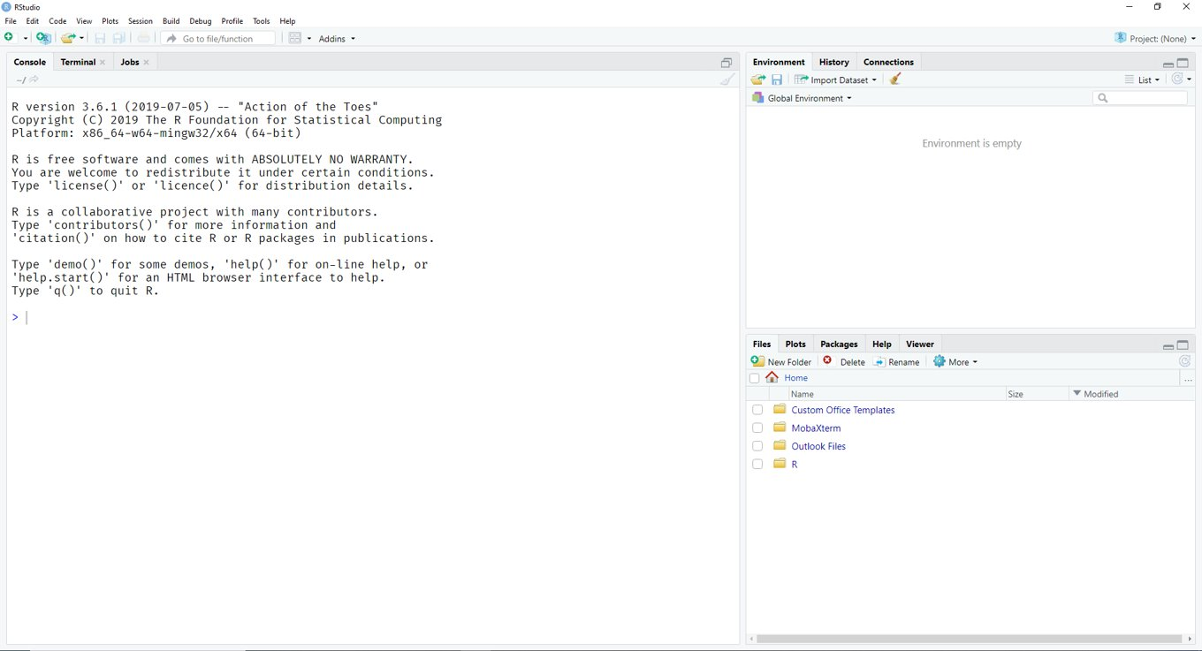
Assigning [or Saving] Variables or Objects
To assign a variable or save it to
your Global Environment, use
<-
This will save the element so that it can be used later
Be careful not to accidentally overwrite an object
Create an object named num_observations with a value of
num_observations <- 336
Create a vector named x with a value of letters A to E
x <- c("A", "B", "C", "D", "E")
Create a 6 x 6 matrix named lucky filled with a 7's
lucky <- matrix(7, nrow = 6,
ncol = 6)
Type the name of each object and then hit enter to display its value

Slide 5
Using Functions
Functions can be help you with data management and data analysis
Each function has a name and one or more arguments, formatted as such
Function_name(arg1 = …, arg2 = …)
Some useful functions include:
c()
length()
dim()
mean()
median()
min(), max()
round()
Note: R is case sensitive
Create a vector named yay with a value of numbers 1 to 6
yay <- c(1:6) *note the :
Find the length of yay
length(yay)
Find the dimensions of the matrix named lucky
dim(lucky)
Find the mean and median of yay
mean(yay)
median(yay)

Slide 6
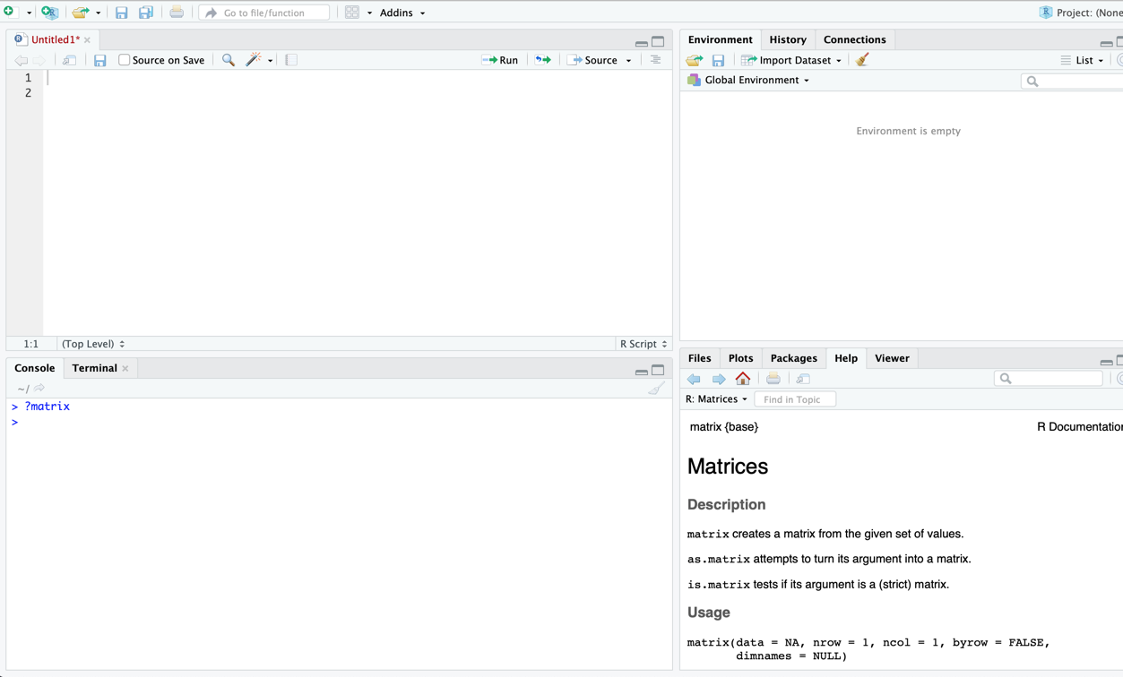
Help with Functions
What do you do when you have a problem in R (or in life)?
Ask R for help
Google it
A and B
None of the above
Answer: C
To ask R for help, use a ? followed by the function name (ex. ?mean)
Google is an excellent resource. If you have a question or problem, the answer or solution can almost always be found online
Ask R for help using the matrix function
?matrix

Slide 7
R Packages
R comes preloaded some functions, but you can also find additional functions in other ‘packages’
To install a new package, use the function install.packages("example")
To load the library after installation, use the function library("example")
Some useful packages
dplyr for data manipulation
data.table for data manipulation
ggplot2 for plotting
tidyr for data manipulation
Note: Misspellings create this error message = ‘is not available (for R version 3.6.1)’
Install dplyr
install.packages("dplyr")
Load dplyr
library("dplyr")
Open the help file for the mutate function
?mutate

